Slide 1
Reliable and Trustworthy AI
Course
Paper review
By: Rahel Sileshi
12/07/2024

Slide 2
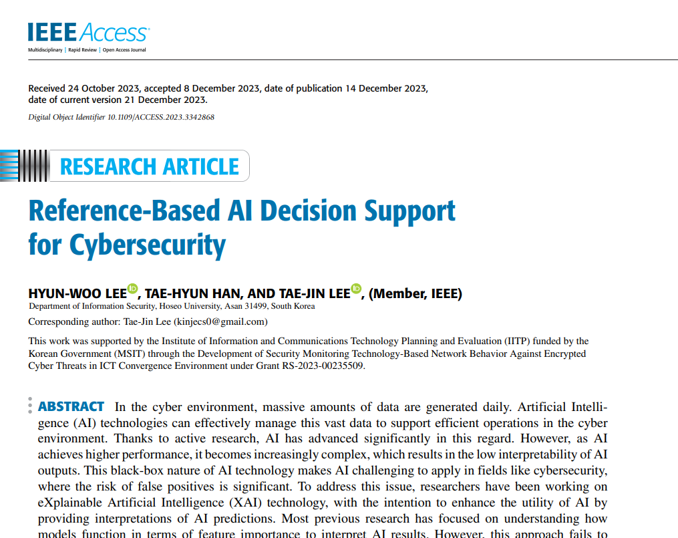

Slide 3
Introduction
Research paper Reviewed:
“Reference-Based AI Decision Support for Cybersecurity, 2023.”
The purpose of this study is to develop a framework that enhances the interpretability of AI results in the context of cybersecurity, where the risk of false positives is high.

Slide 4
Objectives
General objective
The general objective of this study is to develop a robust and interpretable AI decision support framework for the cybersecurity field.
Specific objectives
To provide Clear Interpretations for the Security Field.
To support Effective False Alarm Reduction
To enhance Reference Generation Performance

Slide 5
Research questions
How to generate clear and suitable interpretations of AI results for the security field using Feature Value Comparison?
How effective are the metrics such as References and P-Values in detecting and reducing false alarms in AI-driven security systems?
What improvements can be made to the existing Reference generation logic to maximize its significance and performance?

Slide 6
Problem statement
Existing XAI using feature importance-based methods do not provide clear explanations for cybersecurity anomalies
Early anomaly detection is crucial for cybersecurity but current XAI methods produce high false alarm rates adding more burden on security analysts.
Moreover, the current logic for generating references needs improvement to enhance its performance, success rate, and efficiency
XAI in unsupervised learning is important(cybersecurity cases)

Slide 7
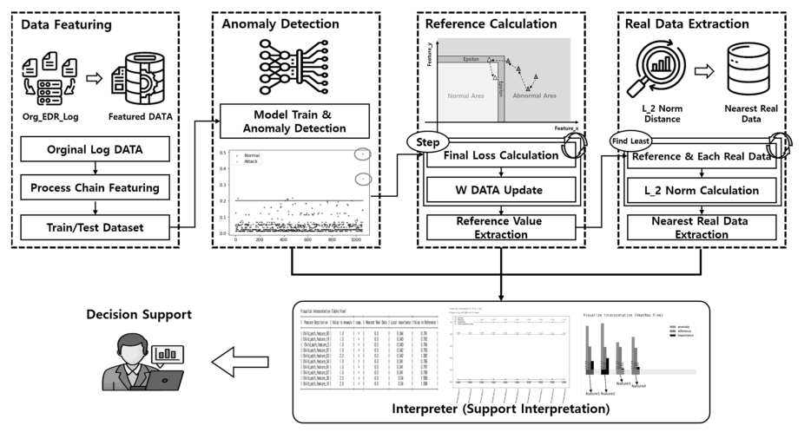
Proposed method

Slide 8
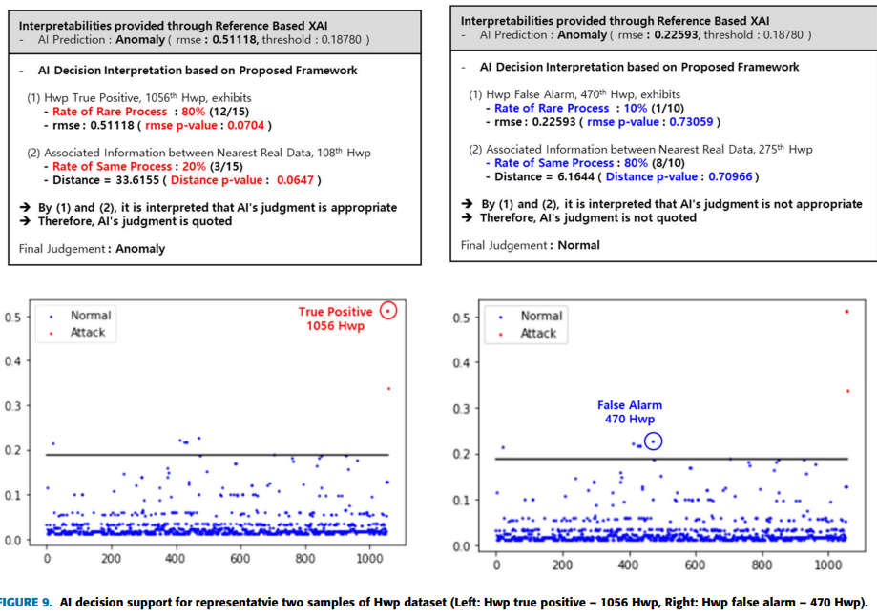
Result

Slide 9
Discussion
The figure shows the effectiveness of the proposed feature value comparison in distinguishing true positives from false alarms within the Hacking Web Pages (HWP) dataset
The FVC technique provides clear and context-aware explanations, highlighting the rate of rare processes and associated nearest real data.
By identifying between significant metrics such as RMSE and distances true positive and false alarms were distinguished

Slide 10
Overall analysis on the paper
The paper provided more accurate and actionable insight into the application of XAI cybersecurity and it became reliable
FVC-based XAI technique demonstrates significant improvements in overall interpretability and false alarm reduction
The study confirms that for each domain and according to its importance, development of XAI techniques are crucial

Slide 11
Conclusion
An AI Decision Support Framework tailored for security environments, demonstrating its capability to offer clear and actionable interpretations even in unsupervised learning scenarios is introduced.
Significant improvements in performance and functionality compared to previous methodologies were shown

Slide 12
THANK YOU!!!

